Slide 1
Introduction to the eFlows4HPC software stack and HPC Workflows as a Service methodology
Jorge Ejarque (BSC), Jedrzej Rybicki (JSC), Rosa M Badia (BSC)
EAB Meeting – Barcelona, 22nd of March 2023

Slide 2
Agenda
9:00 – 9:15 | Overview of eFlows4HPC project and tutorial agenda | Rosa M Badia (BSC)
9:15 - 9:35 | Part 1.1: Integrating different computations in PyCOMPSs | Rosa M Badia (BSC)
9:35 – 10:05 | Part 1.2: HPC ready container images | Jorge Ejarque (BSC)
10:05 - 10:35 | Part 1.3: Data Pipelines and Data Logistics Service (DLS) | Jedrzej Rybicki (JSC)
10:35 - 10:55 | Part 1.4: TOSCA Orchestration and HPCWaaS | Jorge Ejarque (BSC)
10:55 – 11:00 | Conclusion of part 1 | Rosa M Badia (BSC)
11:00 - 11:30 | Coffee break
11:30 - 12:05 | Part 2.1: Hands-on session: How to build HPC Ready containers | Jorge Ejarque (BSC)
12:05 - 12:30 | Part 2.2: Hands-on session: How to move data with the DLS | Jedrzej Rybicki (JSC)
12:30 - 12:45 | Part 2.3: Video demonstrating deployment with Allien4Cloud
12:45 - 13:00 | Tutorial conclusions | all presenters

Slide 3
Part 1.1: Integrating different computations in PyCOMPSs

Slide 4
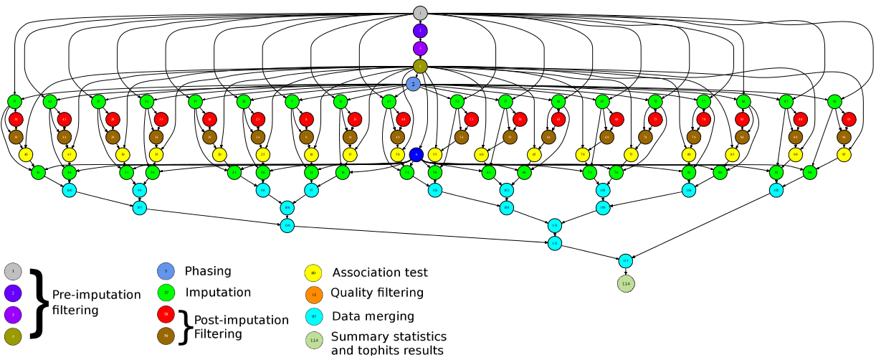

Main element: Workflows in PyCOMPSs
Sequential programming, parallel execution
General purpose programming language + annotations/hints
To identify tasks and directionality of data
Builds a task graph at runtime that express potential concurrency
Tasks can be sequential and parallel (threaded or MPI)
Offers to applications the illusion of a shared memory in a distributed system
The application can address larger data than storage space: support for Big Data apps
Support for persistent storage
Agnostic of computing platform
Enabled by the runtime for clusters, clouds and container managed clusters
@task(c=INOUT)
def multiply(a, b, c):
c += a*b

Slide 5

PyCOMPSs syntax
Use of decorators to annotate tasks and to indicate arguments directionality
Small API for data synchronization
Tasks definition
@task(c=INOUT)
def multiply(a, b, c):
c += a*b
Main Program
initialize_variables()
startMulTime = time.time()
for i in range(MSIZE):
for j in range(MSIZE):
for k in range(MSIZE):
multiply (A[i][k], B[k][j], C[i][j])
compss_barrier()
mulTime = time.time() - startMulTime

Slide 6
Synchronization
Main program and tasks do not share the same memory spaces
The synchronization compss_wait_on waits for tasks generating the parameter to be finished and moves the data from the remote node to the node where the main program is executed:
Tasks can be also synchronized with a barrier
a = compute (b)
#compute is a task, here we can not check the value of a
...
a = compss_wait_on (a)
#here we can check the value of a
if a:
...
startMulTime = time.time()
for i in range(SIZE):
compute (A[i], B[i])
compss_barrier()
mulTime = time.time() - startMulTime

Slide 7
Other decorators: Tasks’ constraints
Constraints enable to define HW or SW features required to execute a task
Runtime performs the match-making between the task and the computing nodes
Support for multi-core tasks and for tasks with memory constraints
Support for heterogeneity on the devices in the platform
@constraint (MemorySize=6.0, ProcessorPerformance=“5000”, ComputingUnits=“8”)
@task (c=INOUT)
def myfunc(a, b, c):
...
@constraint (MemorySize=1.0, ProcessorType =”ARM”, )
@task (c=INOUT)
def myfunc_other(a, b, c):
...
Notes:
Bogomips: En mobils bé estan al voltant de 38 i en laptops a mi em surt 5187

Slide 8
Failure Management
Interface than enables the programmer to give hints about failure management
Options: RETRY, CANCEL_SUCCESSORS, FAIL, IGNORE
Implications on file management:
I.e., on IGNORE, output files: are generated empty
Possibility of ignoring part of the execution of the workflow, for example if a task fails in an unstable device
Opens the possibility of dynamic workflow behaviour depending on the actual outcome of the tasks
Tasks can raise exceptions
Combined with groups of tasks enables to cancel the group of tasks on the occurrence of an exception
@task(file_path=FILE_INOUT)
def comp_task(file_path):
...
raise COMPSsException("Exception raised")
@task(file_path=FILE_INOUT, on_failure='CANCEL_SUCCESSORS’, time_out=‘$task_timeout’)
def task(file_path):
...
if cond :
raise Exception()
def test_cancellation(file_name):
try:
with TaskGroup('failedGroup’):
long_task(file_name)
long_task(file_name)
executed_task(file_name)
comp_task(file_name)
cancelledTask(FILE_NAME);
cancelledTask(FILE_NAME)
except COMPSsException:
print("COMPSsException caught")
write_two(file_name)
L
L
E
T
C
C

Slide 9
Other decorators: linking with other programming models
A task can be more than a sequential function
A task in PyCOMPSs can be sequential, multicore or multi-node
External binary invocation: wrapper function generated automatically
Supports for alternative programming models: MPI and OmpSs
Additional decorators:
@binary(binary=“app.bin”)
@mpi(binary=“mpiApp.bin”, runner=“mpirun”, processes=8)
@ompss(binary=“ompssApp.bin”)
Can be combined with the @constraint and @implement decorators
@binary(binary=“app.bin”, workingDir=“/myApp”)
@task()
def func(l):
pass
Notes:
We also provide other decorators that can be used over the task decorator in order to specify specific task implementations, such as mpi, binaries and OmpSs.
The runtime will be in charge of dealing with them.

Slide 10
Support for MPI tasks
Resource manager aware of multi-node tasks
@mpi (runner="mpirun", processes= ”32”, processes_per_node=8)
@task (returns=int, stdOutFile=FILE_OUT_STDOUT, stdErrFile=FILE_OUT_STDERR)
def nems(stdOutFile, stdErrFile):
pass
Node 0
Node 1
Node 2
Node 3
Launches MPI execution with 32 processes
8 processes per node

Slide 11
MPMD applications
The @mpmd_mpi decorator can be used to define Multiple Program Multiple Data (MPMD) MPI tasks
As a result of the @mpmd_mpi annotation, the following commands will be generated:
> cd working_dir_exe; mpirun -n $FESOM_PROCS fesom.x : \
-n $OIFS_PROCS oifs -v ecmwf -e awi3 : -n $RNFMA_PROCS rnfma
@mpmd_mpi(runner="mpirun", working_dir = {{working_dir_exe}},
programs=[{binary="fesom.x", processes = "$FESOM_PROCS" },
{binary="oifs", args="-v ecmwf -e awi3", processes = "$OIFS_PROCS" },
{binary="rnfma", processes = "$RNFMA_PROCS"}])
@task(log_file={Type:FILE_OUT, StdIOStream:STDOUT}, working_dir_exe=DIRECTORY_INOUT)
def esm_simulation(log_file, working_dir_exe):
pass

Slide 12
Tasks in container images
Goal: enable tasks embedded in container images
New @container decorator to be used together with the task annotation
Also supports user-defined tasks
@container(engine="DOCKER", image="ubuntu")
@binary(binary="ls")
@task()
def task_binary_empty():
pass
@container(engine="DOCKER", image="compss/compss")
@task(returns=1, num=IN, in_str=IN, fin=FILE_IN)
def task_python_return_str(num, in_str, fin):
print("Hello from Task Python RETURN")
print("- Arg 1: num -- " + str(num))
print("- Arg 1: str -- " + str(in_str))
print("- Arg 1: fin -- " + str(fin))
return "Hello"

Slide 13
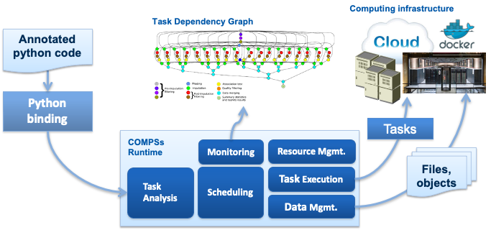
PyCOMPSs runtime
Support for tasks’ constraints – support for heterogeneous infrastructure
Support for tasks’ faults and tasks’ exceptions
Enlarges the dynamicity of the type of workflows that we support
Streamed data
... and many others
Runtime deployed as a distributed master-worker
All data scheduling decisions and data transfers are performed by the runtime
Support for elasticity

Slide 14
Interfaces to integrate HPC/DA/ML
Workflow
HPC Software
DA Software
ML Software
Data Transformation
Data Transformation
Simulation
Data Analytics
ML Training
Goal:
Reduce the required glue code to invoke multiple complex software steps
Developer can focus in the functionality, not in the integration
Enables reusability
Two paradigms:
Software invocation
Data transformations
#workflow steps defined as tasks
@data_transformation (input_data, transformation description)
@software (invocation description)
def data_analytics (input_data, result):
pass
#workflow body
simulation (input_cfg, sim_out)
data_analytics (sim_out, analysis_result)
ml_training (analysis_result, ml_model)

Slide 15
Software Invocation description
Workflow Code
Computing Infrastructure
Admin/user code
{
"type":"mpi",
"properties":{
"runner": "mpirun",
“processes”: “$SW_PROCS”
"binary": "mpi_sofware.x",
"params": "-d {{param}}",
“working_dir”: “{{working_dir}}”},
"prolog":{
"binary":"mkdir",
"params":"{{working_dir}}"},
"epilog":{
"binary":"tar",
"params":"zcvf {{out_tgz}}" {{working_dir}}},
"constraints":{
"computing_units": $SW_THREADS}
}
PyCOMPSs Code
COMPSs runtime
Software Invocation
User code
Automatically generated
#workflow steps defined as tasks
@software(config_file="invocation.json")
def mpi_exec(work_dir, param, out_tgz):
pass
#workflow body
...
mpi_exec('my_folder', 'hello_world’)
...
mkdir working_dir
cd working_dir
export OMP_NUM_THREADS=$SW_THREADS
mpirun -n $SW_PROCS mpi_software.x -d param
tar zcvf out_tgz working_dir
Software invocation description
Stored in software catalog
Converts a Python function of a software invocation to a PyCOMPSs task
Takes information from the description in json
Enables reuse in multiple workflows

Slide 16
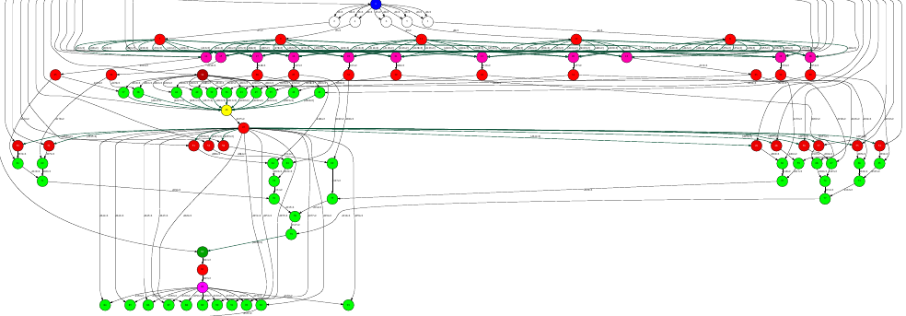
Data transformations
A data transformation changes the data without requiring extra programming from the developer
Admin/user code
def load_blocks_rechunk(blocks, shape, block_size, new_block_size):
...
SnapshotMatrix = load_blocks_array (final_blocks, shape, block_size);
return SnapshotMatrix
@dt("blocks", load_blocks_rechunk, shape=expected_shape, block_size=simulation_block_size,
new_block_size=desired_block_size, is_workflow=True)
@software(config_file = SW_CATALOG + "/dislib/dislib.json")
def rSVD(blocks, desired_rank=30):
u,s = rsvd(blocks, desired_rank, A_row_chunk_size, A_column_chunk_size)
return u
User code
...
model, parameters = load_model_parameters(model_file)
for cfg in sim_cfgs:
sim_results.append(execute_FOM_instance(model,parameters,[cfg]))
rom = rSVD(sim_results, desired_rank)
...
dt
User code
Main workflow program

Slide 17
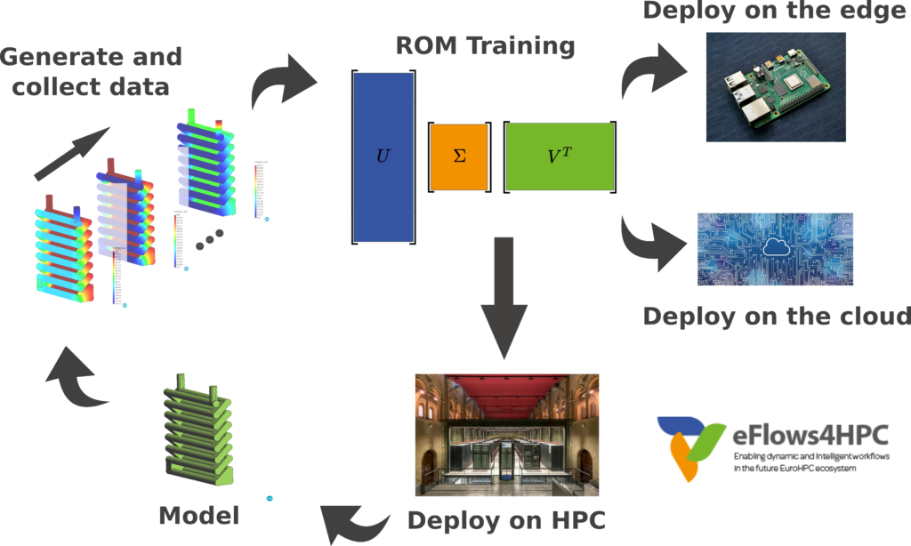
Pillar I: Integration of HPC and data analytics in a single workflow
{
"execution" : {
"type":"task"
},
"constraints" : {
"computing_units": "$KRATOS_CUS"
},
"parameters" : {
"returns" : 1,
"model" : "IN",
"parameters" : "IN",
"sample" : "IN"
}
}
fom.json
@software(config_file = SW_CATALOG+"/kratos/fom.json")
def execute_FOM_instance(model,parameters, sample):
import KratosMultiphysics
from kratos_simulations import RunROM_SavingData
load_ROM(rom)
current_model = KratosMultiphysics.Model()
model.Load("ModelSerialization",current_model)
del(model)
current_parameters = KratosMultiphysics.Parameters()
parameters.Load("ParametersSerialization",current_parameters)
del(parameters)
simulation = RunROM_SavingData(current_model,current_parameters,sample)
simulation.Run()
return simulation.GetSnapshotsMatrix()

Slide 18
Pillar I: Integration of HPC and data analytics in a single workflow
fom.json
def load_blocks_rechunk(blocks, shape, block_size, new_block_size):
....
arr = load_blocks_array(final_blocks, shape, block_size)
return arr.rechunk(new_block_size)
Dislib method that re-partitions a set of blocks into a new ds-array of the given
block size

Slide 19
Pillar I: Integration of HPC and data analytics in a single workflow
dislib.json
{
"execution": {
"type":"workflow"
}
}
Method that invokes other PyCOMPSs tasks inside
@dt("blocks", load_blocks_rechunk, shape=expected_shape, block_size=simulation_block_size, new_block_size=desired_block_size, is_workflow=True)
@software(config_file = SW_CATALOG + "/py-dislib/dislib.json")
def rSVD(blocks, desired_rank=30):
from dislib_randomized_svd import rsvd
u,s = rsvd(blocks, desired_rank, A_row_chunk_size, A_column_chunk_size)
return

Slide 20
Pillar I: Integration of HPC and data analytics in a single workflow
import dislib as ds
@dt("blocks", load_blocks_rechunk, shape=expected_shape, block_size=simulation_block_size,new_block_size=desired_block_size, is_workflow=True)
@software(config_file = SW_CATALOG + "/dislib/dislib.json")
def rsvd(blocks, desired_rank):
k = desired_rank
...
Y = A @ Omega
Q,R = my_qr(Y._blocks)
Q=load_blocks_rechunk([Q], ...)
...
B = Q.T @ A
...
@software(config_file=kratos.json)
def ExecuteInstance (model, parameters, Cases, instance):
...
current_parameters = KratosMultiphysics.Parameters()
...
simulation = GetTrainingData(current_model,current_parameters,sample)
simulation.Run()
return simulation.GetSnapshotsMatrix()
....
for instance in range (0,TotalNumberOFCases):
blocks.append(ExecuteInstance(model, parameters, pars, instance))
...
U, s = rSVD(A, desired_rank)
...

Slide 21
Pillar I: Integration of HPC and data analytics in a single workflow
import dislib as ds
@dt("blocks", load_blocks_rechunk, shape=expected_shape, block_size=simulation_block_size,new_block_size=desired_block_size, is_workflow=True)
@software(config_file = SW_CATALOG + "/dislib/dislib.json")
def rsvd(blocks, desired_rank):
k = desired_rank
...
Y = A @ Omega
Q,R = my_qr(Y._blocks)
Q=load_blocks_rechunk([Q], ...)
...
B = Q.T @ A
...
@software(config_file=kratos.json)
def ExecuteInstance (model, parameters, Cases, instance):
...
current_parameters = KratosMultiphysics.Parameters()
...
simulation = GetTrainingData(current_model,current_parameters,sample)
simulation.Run()
return simulation.GetSnapshotsMatrix()
....
for instance in range (0,TotalNumberOFCases):
blocks.append(ExecuteInstance(model, parameters, pars, instance))
...
U, s = rSVD(A, desired_rank)
...

